Slide 1
Forecasting City Finances
Presenter: Varishth Torul Baluckram
Mentor: Kenneth Gil-Pasquel

Slide 2
Context

Slide 3
Problem Identification
The budgeting at governmental institutions is as important, if not more important, as at private companies
To be able to ensure that a city is able to cover all its expected spendings, proper forecasting of the city’s income is primordial. This study explored this problem and proposed a solution to that end

Slide 4
The Dataset
Name: “Fiscally Standardized Cities database”
Source: Lincoln Institute of Land Policy
Content:
City-level finances for 150 of the largest U.S. cities in a standardized format
Income and expenditures for the years 1977 to 2016 at various levels of local government, e.g: cities, counties, school districts, etc…

Slide 5
Assessing the data

Slide 6
Data Wrangling
“Duplicate” features:
Beginning number of features: 663
Appeared repeated at different governmental levels (for eg: “rev_total” v/s “rev_total_city” v/s “rev_total_cnty”)
Features of interest, fiscally standardized features, were the ones without any suffix (like “city” or “cnty”)
Getting rid of the irrelevant features dropped the count from 663 to 139
Null values: Only 5 features with null entries, likely erroneously entered. These fields were also dropped, bringing total count of features to 658
Notes:
A deeper study of the features available show that there were a lot of sub-categories of the fields which represented too much granularity. For example: ‘education’, ‘educ_higher’ and ‘educ_elem_sec’ were fields that all summed up to another field in the dataset ‘education_services’. Since we did not need all levels of granularity but rather just the high level spendings and earnings of the city, careful cleaning was conducted to only keep the highest level of the different categories in the dataset.

Slide 7
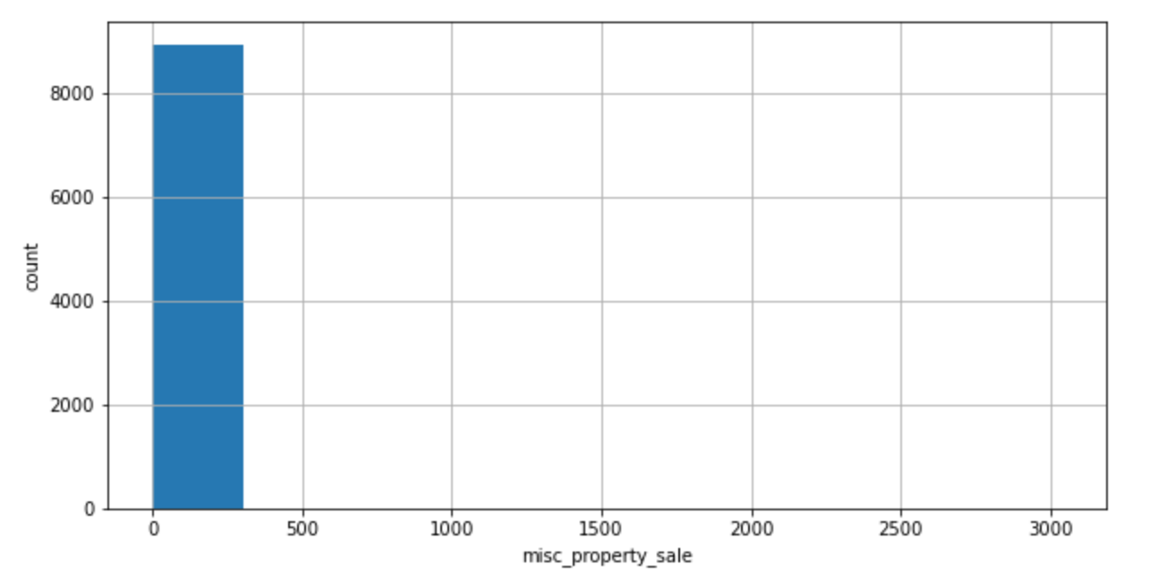
Data Wrangling
Outliers: Histograms highlighted that many features seemed to contain outliers, for example, consider the histogram for the field ‘misc_property_sale’

Slide 8
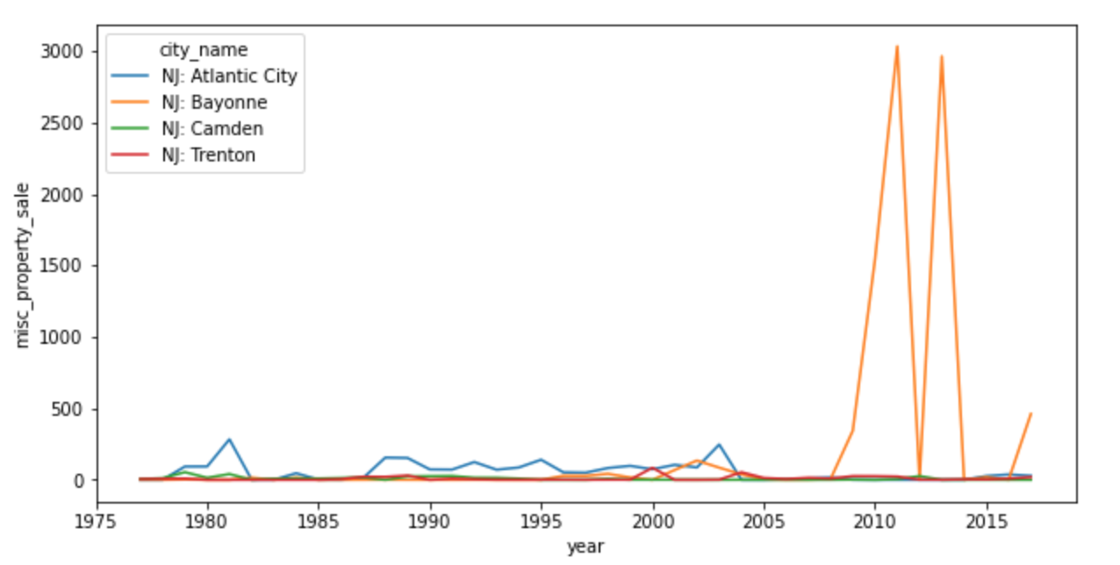
Data Wrangling
Exploration revealed that the source of the outlier was one specific city, NJ: Bayonne. This city has two very unjustifiably large (~300x higher) values compared to neighboring

Slide 9
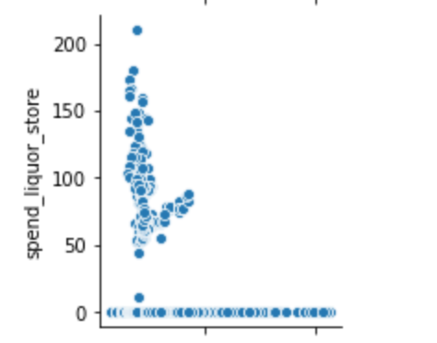
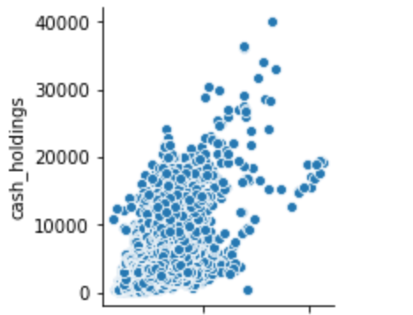
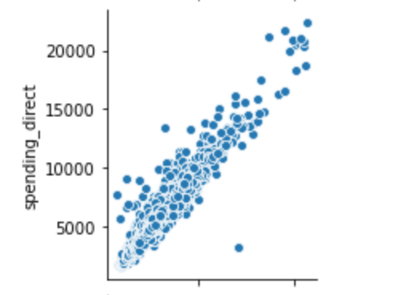
Exploratory Data Analysis
Target variable: rev_total field
Exploratory variables depend potential modeling approaches:
Method 1: use historical expenditure data to predict income (regression models), or
Method 2: use historical income data to predict income (ARIMA models).
Correlation of other fields against the target variable examples:
Notes:
The three examples above are scatter plots of three features against the target variable rev_total. As visible there were some features that were completely unrelated to the city's income, such as the spending on liquor stores, while other features showed more correlation such as cash holdings of the city. However, rather intuitively, the feature that showed the most correlation with the city’s income was the city’s direct spending. This exercise highlighted that the features at hand were not instructive features that helped inform the city’s income, but rather features that were simply resulting from the city’s income. Therefore, trying to use these features to forecast the income did not make much sense.
With this finding, Method 2 (auto-regressive moving average models) was chosen as the best way to predict the city’s income

Slide 10
Exploratory Data Analysis
Varying levels of correlation
The highest correlation with the city’s income was the city’s direct spending
Features at hand were not instructive features that helped inform the city’s income, but rather features that were simply resulting from the city’s income
With this finding, Method 2 (ARIMA models) was chosen as the best way to predict the city’s income

Slide 11
Modeling

Slide 12
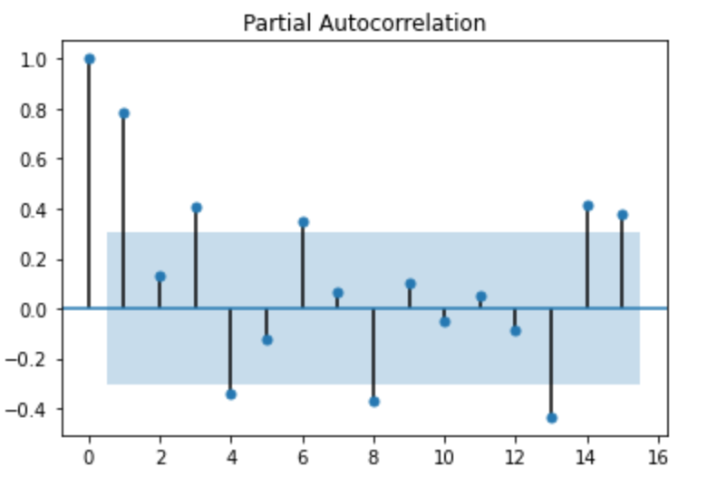
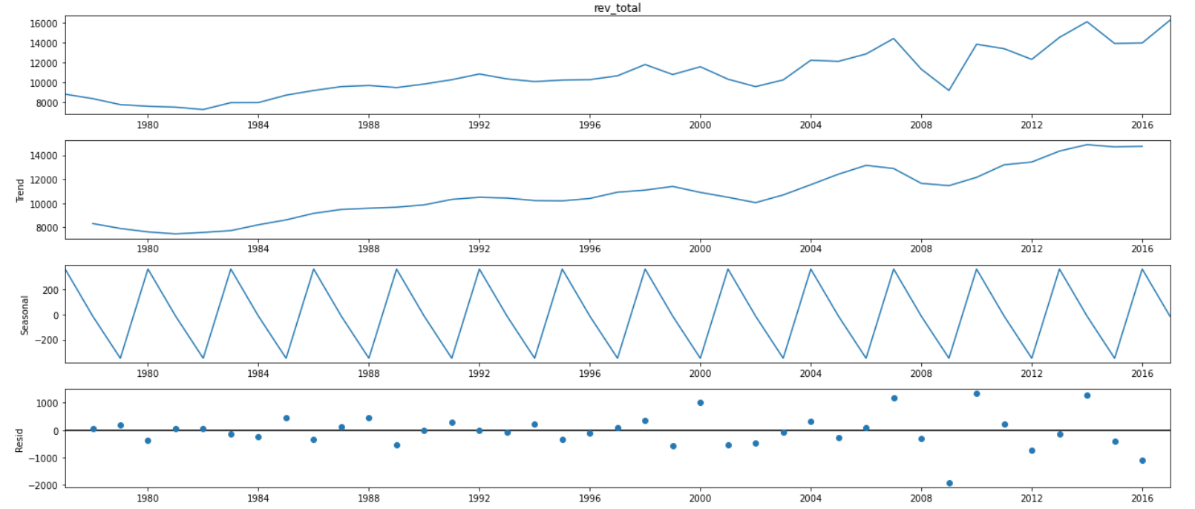
Preprocessing
NY: New York as a subset of the dataset for assessing classic characteristics for time-series analyses, such as auto-correlation, seasonality, and stationarity

Slide 13
Preprocessing
Plots below are obtained using the the statsmodels library
No strong seasonality and time series is mostly correlated to 1 or 2 lags
Non-stationarity confirmed this finding by applying the Dickey-Fuller test. Best method for achieving stationarity was a log-difference method

Slide 14
Training and Testing
Each city needs an ARIMA model specific to its time-series data
Methodology for the training, modeling and testing:
Find the hyperparameters (p, d, and q for ARIMA) that best suit each time-series for each city
Use the first 85% of the dataset for a city to train the ARIMA model
Using trained model, predict the next data point
Add predicted data point to first training set, and repeat training and prediction until the remaining 15% of the dataset is predicted
Evaluate the performance of the ARIMA model, using mean squared error. The p-d-q hyperparameter combination leading to the lowest error is chosen as the best ARIMA model for that city
Repeat for all cities

Slide 15
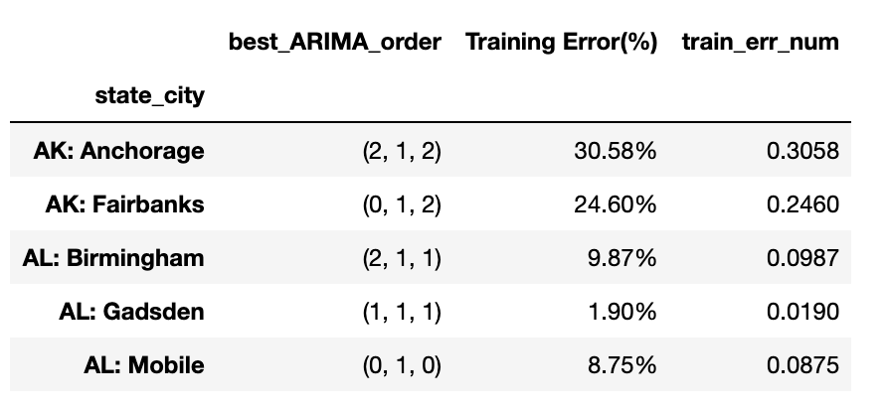
Training and Testing
Below is a snippet of data frame showing the result of the best ARIMA models obtained from training every city’s data using the described methodology

Slide 16
Model performances

Slide 17
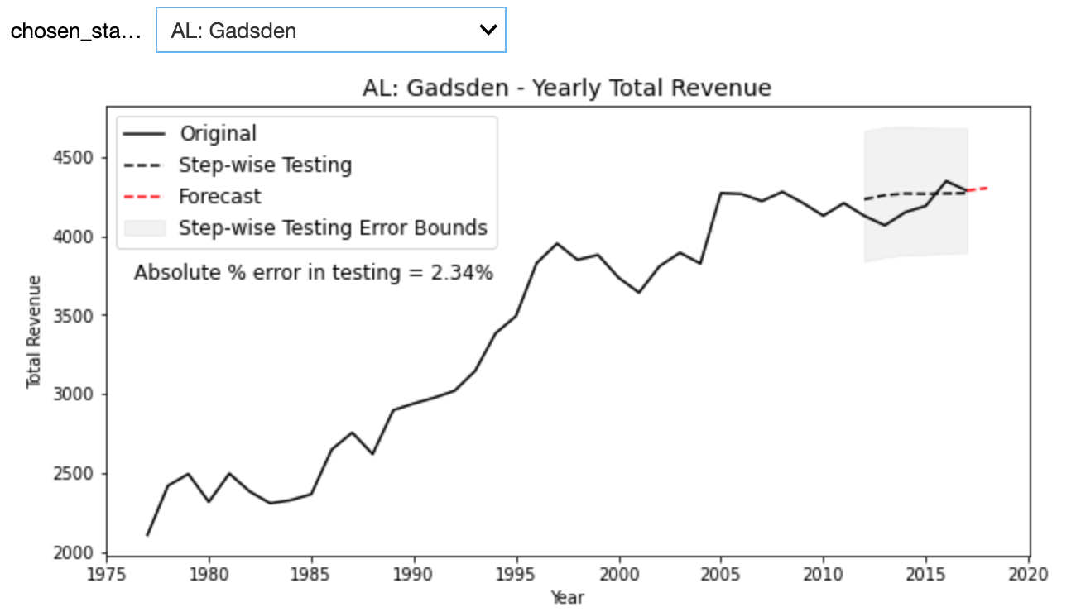
Results and conclusion
For each city, use best ARIMA model to forecast an out-of-sample data point, which was the desired purpose of this whole exercise!
A widget was created for ease of visualisation and to toggle between cities

Slide 18
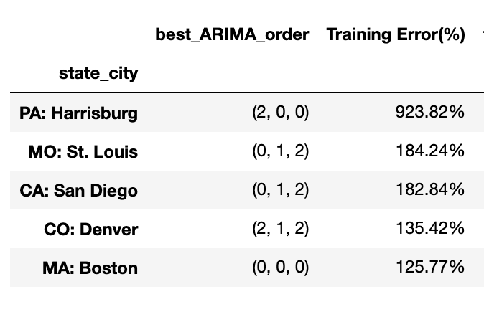
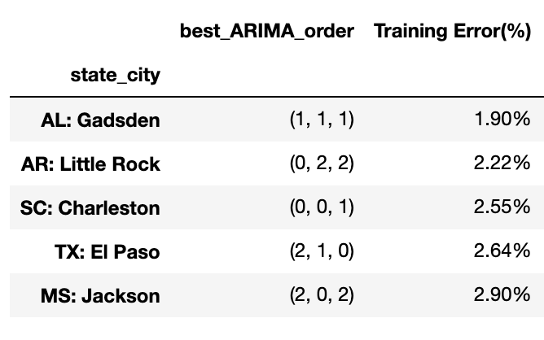
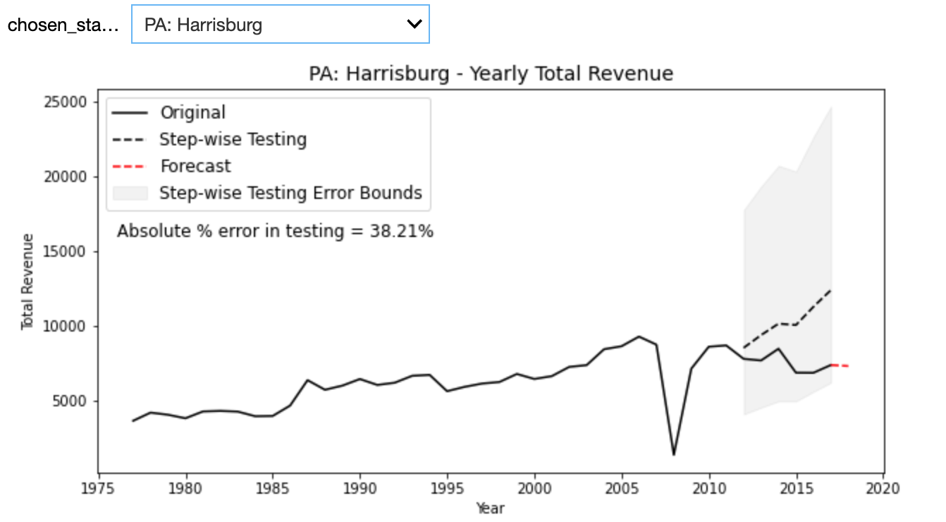
Results and conclusion
Worst performing models
Best performing models

Slide 19
Results and conclusion
In the worst performing model, the training error was as high as 924% but the deviation from real data measured as “Absolute % error in testing” is ~38%
In the best model, “Absolute % error in testing” drops to <2.5%!
Poor performance was due to the presence of big/significant fluctuations in the historical data (like the one visible in the plot on the left below)

